Slide 1
CATRACT DETECTION IN HUMAN EYE
GUIDED BY
SUBMITED BY
MS.SANDHYA C
ANJUMOL M.V
ASST PROFESSOR
ROLLNO 10
SNGCE

Slide 2
Introduction
Catract is the one of the most common diseases that might couse blindness.Considering the fact that retinal image is one of the most important medical refrences that help to diagonose the catract .Here propose to use a neural network classifiear for automatic catract detection based on the classification of retinal images.The classifier building procedure include three parts preprocessing,feature extraction and classifier construction based on the clearness of images.

Slide 3
Block Diagram

Slide 4
Feasibility study
A feasibility study is a preliminary study under taken to determine a project viability.the results of this study are used to make decision whether to proceed with the project.
Techinical feasibility
The assement of thnical feasibility must be based on outline design of system requirement interns of input,output,files programs and procedures.

Slide 5
Hardware requirement
System :pentium IV or higher
Harddisk :40 gb
Monitor :15 VGA color
Mouse :Liegitech
Ram :4gb
Software requirement
Operating system :windows 7
Frond end :matlab
Back end :machine learning,image processing

Slide 6
Social feasibility
This technology is an advanced concept with image processing and machine learning.in this method a series of input image are given and it will predict the accurate stage of disease that affected to the eye.

Slide 7
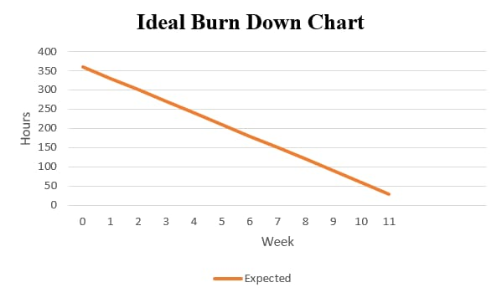
Burn Down Chart

Slide 8
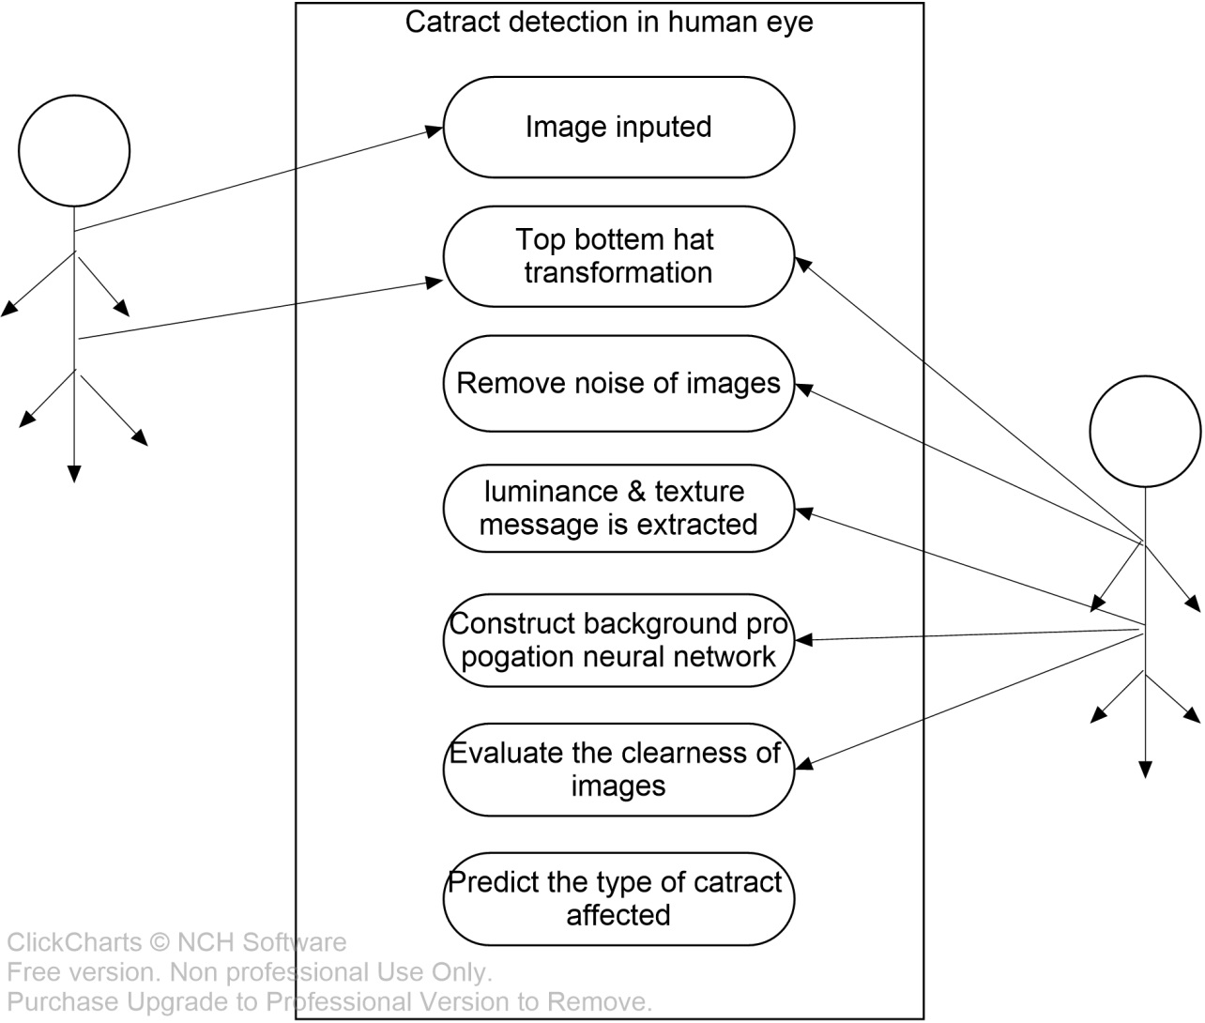
USECASE DIAGRAM

Slide 9
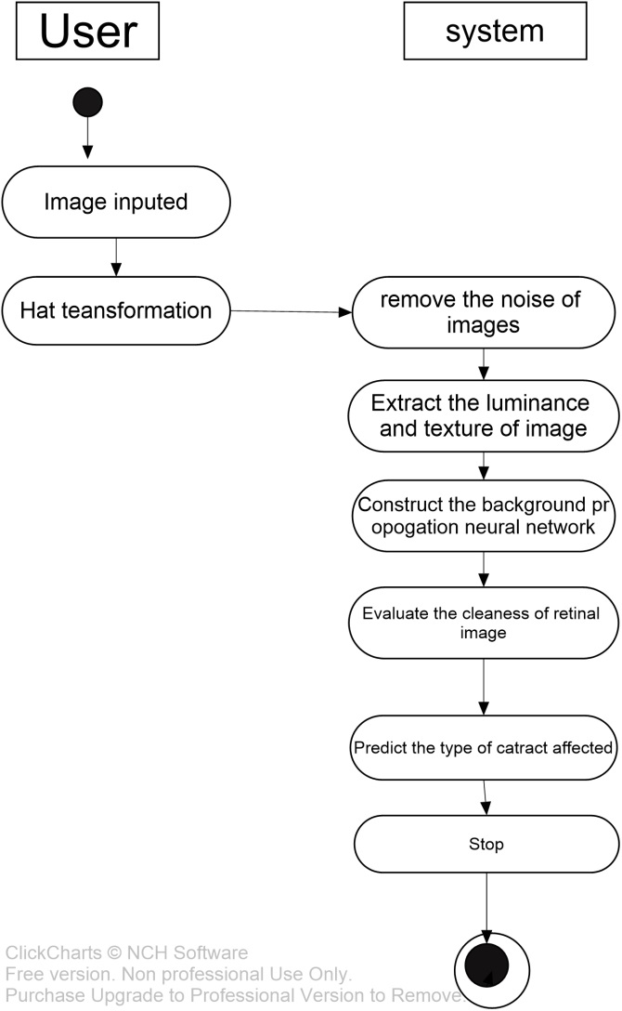
ACTIVITY DIAGRAM

Slide 10
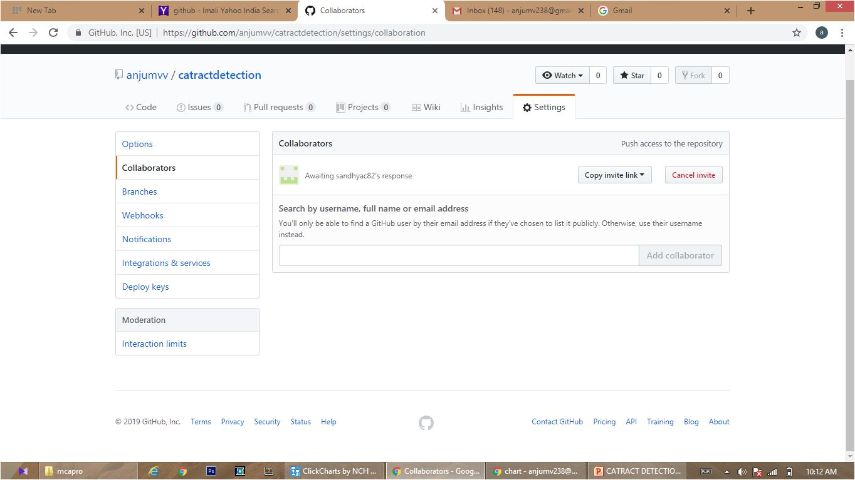
Githhub

Slide 11
References
Medical image analysis vol 13
Universal noise removal algorithm,image processing

Slide 12
THANK YOU

